Slide 1
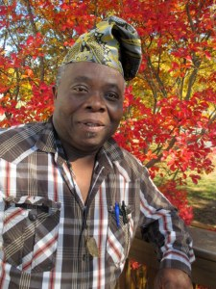
TUNDE ODUNLADE Nigerian Artist And Musician
Tunde Odunlade is a print and textile artist who has exhibited, taught, lectured, studied and traveled extensively within Nigeria and throughout Africa, North America, and Europe. In addition, he has performed as an actor with the Nigerian National Troop and various other theatrical organizations, and has recorded several CDs that integrate poetry and music. He lives in Ibadan, in the southwestern part of Nigeria.
His art has been displayed in dozens of one-man and group shows. His work is in the collections of institutions including the Smithsonian Museum of African Art and the World Bank Headquarters in Washington, D.C., the Victoria and Albert Museum in London, the MacArthur Foundation Collection in Chicago, and the State House in Lagos, Nigeria. His work is also in the collections of many private individuals in the North America, Europe, and Nigeria.
In the early 1970’s Tunde studied with Yinka Adeyemi, a member of the Oshogbo school of art that was largely responsible for the explosion of creative contemporary art emanating from Nigeria, and at the Oguntimehin Art Workshop under the auspices of Obafemi Awolowo University in Ile-Ife.
Tunde’s art uses both contemporary and traditional techniques. For example, he developed a unique batik appliqué process that builds on traditional textile print techniques to create wall hangings with unusual depth and texture. His favored technique for making prints is linocuts. Recently, he developed a new style he calls “floatograph” that combines the techniques of marbleizing, calligraphy, and batik to create organic abstractions.
His images draw on the rich history of Yoruba art and culture, modern-day life in Nigeria, and his passion for music. He does not create “art for art’s sake.” Rather, he is committed to “art with a purpose:” the use of art to reach across cultural differences, raise awareness among his own people and the international community about both the potential and the challenges facing Nigeria.
Tunde has always been deeply committed to expanding opportunities for other artists. He co-founded the Toki Memorial Arts Centre in Ibadan, where he served as artistic director for 14 years. This center became a major force in discovering and nurturing artists who have gone on to successful international careers. He founded the International Campaign for Better Arts and Cultural Awareness (ICBACA), a non-profit organization dedicated to using art to bridge gaps between cultures – both at home in Nigeria and abroad. He founded its sister organization, a for-profit gallery and artist representation services, the International Center for Better Arts and Cultural Arcade (ICBACA Ltd) and the Tunde Odunlade Artist Cooperative Gallery in Ibadan.
In addition, Tunde has devoted considerable energy toward improving conditions in Nigeria. In 1999 he founded the Nigerian Artists for a Nation Anew (NAFANA), whose mission is to encourage Nigerian artists to use their talents to help their country overcome the corruption and poverty that has plagued it for decades. Through NAFANA Tunde curated a major exhibition entitled “Artists and Nation-Building: Nigeria at 39.” In 2001 he was commissioned by the Nigerian Debt Management Office (DMO) to curate a show as part of their International Conference on Sustainable Debt and Development Strategy. For the exhibition, “Together, We Rebuild a Nation,” artists were asked to depict both their dreams for their country and the ways in which oppressive external debt is hampering their realization. Tunde also serves as an executive with the Association of Nigerians Against Corruption (ANAC).
Tunde Odunlade’s life is well described by his motto: “He who does not attempt the absurd can never achieve the impossible.”

Slide 2
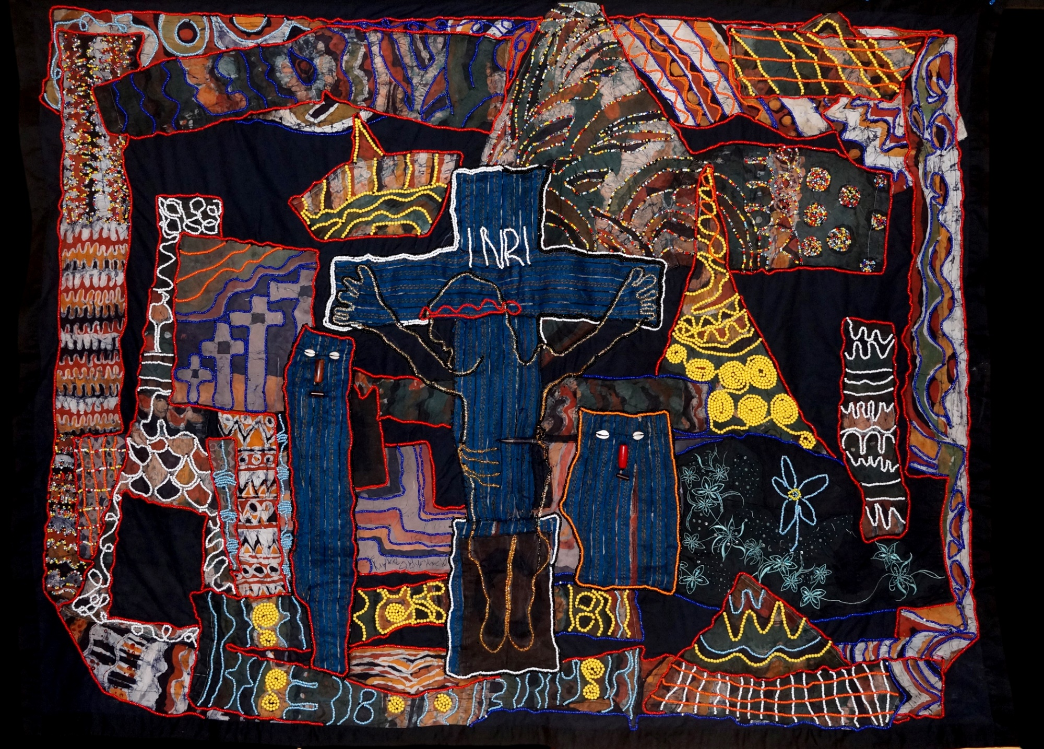
Title: At the Calvary
Medium: Beaded Batik Quilt Tapestry
Year of Production: 2014-2018
Artist: Tunde Odunlade
size: 4ft-9ins by 6ft-3ins
Collection: Estate of the Artist
Provenance: Was Exhibited in Galleries.

Slide 3
At the Calvary Artist’s inspiration on the piece
Jesus Christ the Lord was crucified at a tender age of thirty three (33) to fulfill the “Word” as written before thee. He came to deliver the world with the good tiding of LOVE as the only way back to thy creator after a wondrous and fulfilling life, irrespective of who you are or what your beliefs are. Therefore, his message goes beyond mere religious sentiments, but a life of reality. Because, ‘Love is real’. Unfortunately, what has the word “LOVE” has been turned to by the movers and shakers of the dark world. Lust Over Vulnerable Ecumenical The followers of Christ are referred to as Christians but those who truly recognize his message and live by it are called “Chrislikitians” in other word, “Christlikeism” should have been more propagated and we would have been freed of this pervasive preaching of wrong tidings full of lasciviousness, greed and hypocrite menacing our world today. That good tidings would have crossed all strata. On the right hand of Christ is the thief who recognized Jesus as the Lord and Savior and acknowledged his innocence. Jesus then said to him “verily I say unto thee, today shall thou be with me in paradise” he was elevated. Where as, the thief on the left denied Jesus Christ but was relegated. If you truly go the way of Christ, you are under his watch and protection as depicted with the zipper underneath the cross on this piece. The thief on the right has a pocket that depicts his salvation. The beautiful colors surrounding Crucifixion depict all the wonderful deeds of Christ. Tunde Odunlade August 2019.

Slide 4
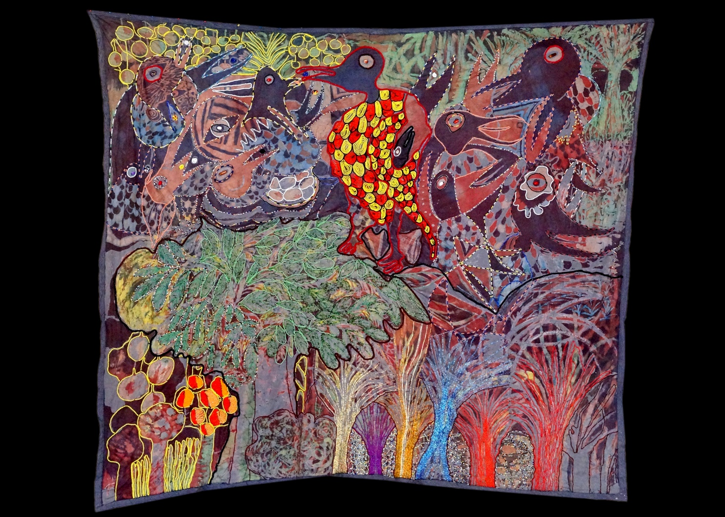
Title: Eiye t’o njeso kii ke
Medium: Batik Quilt Tapestry
Year of Production: 2014-19
Artist: Tunde odunlade
Size: 12ft.2ins by 10ft.
Collection; Estate of the Artist
Provenance: Has been Exhibited Galleries.

Slide 5
Eiye t’o njeso kii ke Artist’s inspiration on the piece
Yoruba says, “eiye t’o njeso kii ke” literally translates as, A bird with seeds in its mouth, doesn’t whistle.
One who is comfortable doesn’t grumble, only the poor grumbles.
This piece takes a deep look into how one part of the society has more than enough and the other part has nothing.
Jimmy Cliff sings,
“Too many people are suffering
too many people are dying
very little people got everything
while too many people got nothing
remake the world with love and happiness
remake the world, be you black
be you white, remake the world...”
What is that life that has no impact on others? Some create jobs, provide enabling environment for others to prove their worth and make life a better place to be, for others.
That’s what I call a fulfilling life, a life well spent, a life full of Legacy. An ideal that will outlive its author.
The big colorful bird to the right of the piece represents the ‘HAVES’ with plenty as you can see the family has food to eat. While the bird to the left represents the ‘HAVE-NOTS no food’.
Contribute your quota now before its too late. “orun t’o ku loke o to aso gbe” literally means’ the sun still left up the sky can still help dry your laundry before the sunsets.
“Make hay while the sun shines” AU. Tomorrow may be too late. Live your life for others to live.
Tunde Odunlade
September 2019.

Slide 6
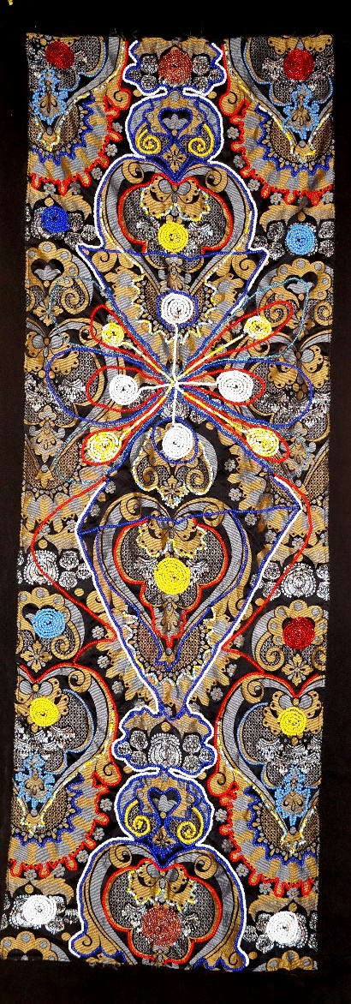
Title of work: Prayers
Medium: Beaded Damask tapestry (BDT)
Year of Production: 2019
Artist: Tunde Odunlade
Size: 5ft-2ins by 2ft-1ins
Collection: Estate of the Artist

Slide 7
Prayers Artist’s inspiration on the piece
This piece takes a deep-cut into prayer as a tool every creature uses to seek spiritual atonement in service to get closer to their creator (God) and be rewarded towards divine protection, prosperity and ultimately to secure eternity or salvation etc. If so desires.
Whichever your religious belief, the primary purpose certainly revolves around one of the above mentioned phenomena.
Even though I still recognize that prayer may not necessarily be religiously undertone, but rationally, it is save to say that prayer and religious beliefs go pari parsu. Even if you are an Atheist or a free thinker, ultimately, it all boils down to “Faith and or Practicality”
Be that as it may. Lets take a swipe at Stephen Prothero’s book “God is not one” which says, “Religions are different paths up the mountain (“different starting points, same ending point”)
Having understood this, it is therefore necessary to bring to the fore the different ways man can communicate with his creator through praying.
There are five different types of prayers that every one is as effective as the other;
1) Silent prayer
2) Ejaculatory prayer
3) Congregational prayer
4) Intercessory prayer
5) Thoughts (that is; power of positive thinking and deeds).
All of the above mentioned prayers work just as perfect, but the most potent is ‘thought’ which, if missing, it may hamper the potency of the other four.
Therefore, you don’t ever think negative to the extent that you commit it to the universe, it may not go without coming to pass. Be careful what and how you think and say about yourself and about other people too. Thoughts are prayers which reflects in our deeds. Like the old cliché, “Human’s actions, are preceded by thoughts”.
Tunde Odunlade
August 2019

Slide 8
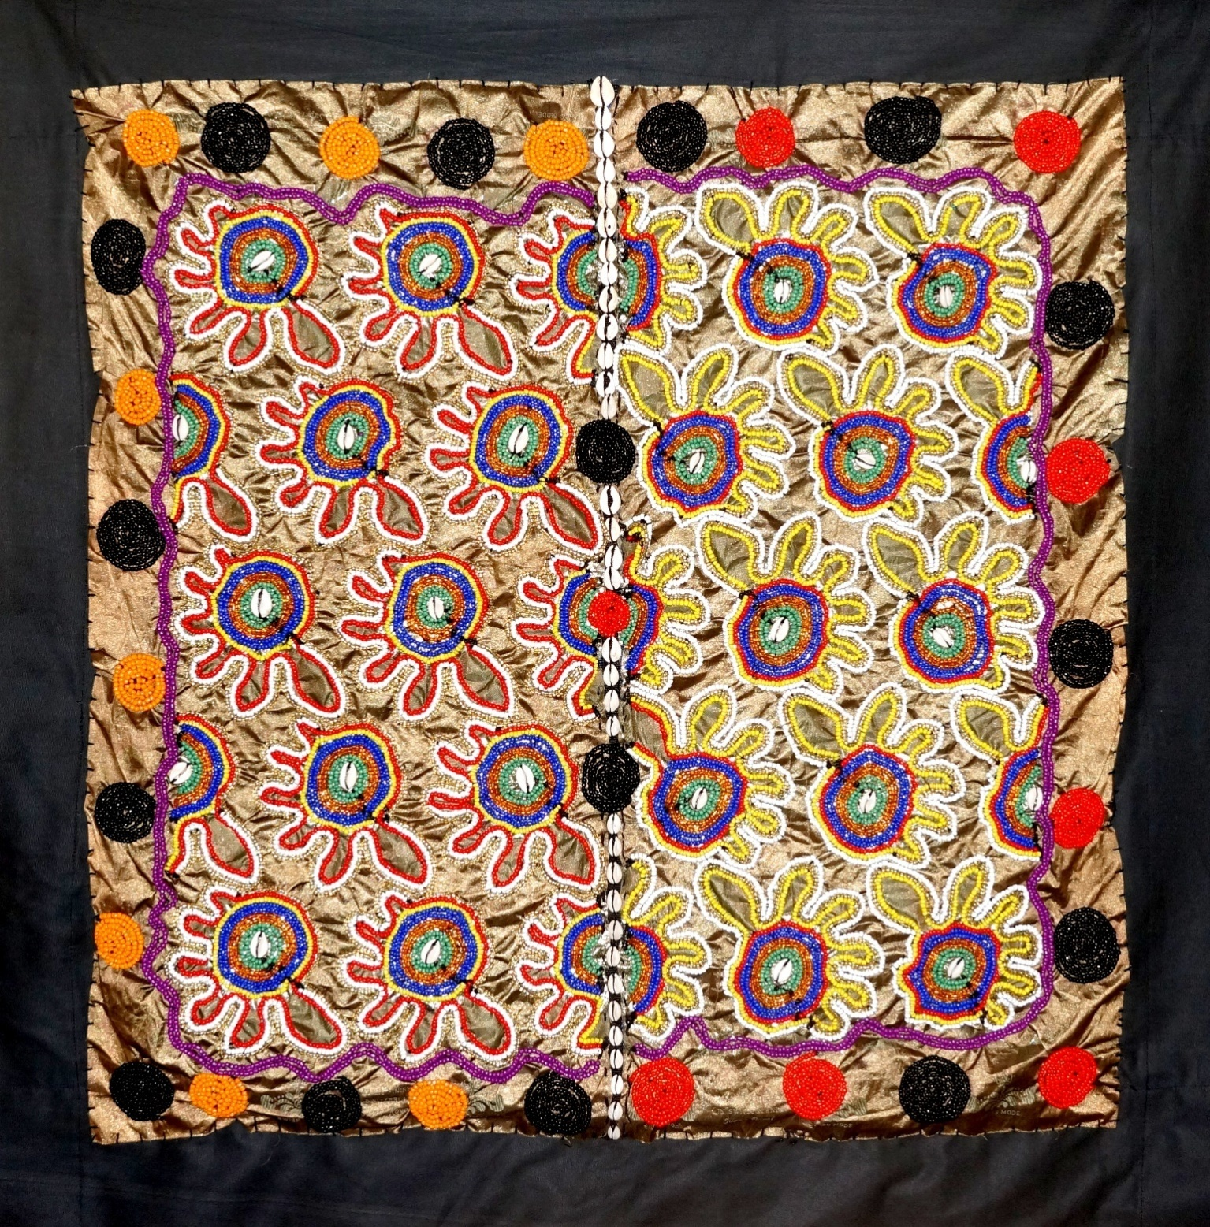
Title: Olugbodi
Medium: Beaded Damask Tapestry (BDT)
Year of Production: 2019
Artist: Tunde Odunlade
Size: 41ft by 40-1/2ins
Collection: Estate of the Artist

Slide 9
Olugbodi Artist’s inspiration on the piece
Olugbodi “Omo t’oni‘ka mefa, ni’jOlugbodi” Olugbodi a Yoruba given name literally translates as A child naturally born with six fingers is named Olugbodi. An Olugbodi is a naturally prosperous child which explains the use of cowrie shells on this piece, cowrie is commerce. Count the fingers in each of the figures, they will give you six six.
Whereas, the one born bringing his/her legs out first is named Ige, At’ese bi ni’ge, Ige Ladubi keke nsogba rondo bi eiye okann. And he/she has his/her characteristics peculiar to them, as well.
Every Yoruba child gets his/her name during a naming ceremony conducted according to tradition of the said family either on the sixth day or seventh day if a female child and on the eighth day or the ninth day if a male child, or as the case may be.
Shakespeare says; “What’s in a name” to the Yoruba people of Southwestern Nigeria, there is a lot of importance attached to a name, as a matter of fact, it is said to be the vanguard of what the future may hold for the child. Like we say, Oruko omo ni j’anu omo ati oruko omo nii ro omo, that is; the name of a child is his/her vanguard, that which, goes beyond mere identification.
Yoruba has three categories of given name,
1) Oruko amut’orunwa (name brought from heaven) which means the name the child was born with, naturally. Like Olugbodi, Ige, Oke, Ojo, Aina and Ibeji (Twins). etc
2) Oruko abiso That is; a name given to the child as the parents desire, going by the circumstances of the family when the child was born e.g. Omolaja meaning Child separates rifts, Oluwatamilore meaning God has given me a precious gift Etc.
3) Oruko abalaiye: that is; a name given according to the history or antecedents of the family in question, that which, could be associated with the family traits or trade or inheritance e.g. Ade (Crown) Adeyemi Crown befits me, Adetayo Crown is worthy of joy or Ola (wealth) Ola, Oladayo means, wealth metamorphosis into joy. Or a name which has to do with religion (Ogun, Sango, Oya, Ifa, Osun, Sodo or Oje and Akin Etc) Ogundeji, that is; a second male child in the family of Ogun; Osunseyi Osun has brought this to bear; Oyafemi means Oya loves me; Sangodare meaning Sango has vindicated me. Sodo or Oje has to do with masquerade Oje Ojelabi meaning we have given birth to a masquerader.
Ifagbemi meaning Ifa the oracle rewards me. Akin has to do with bravery. It could mean the family pedigree are warlords or community leader so a name like Akinboboye means bravery comes at a time chieftancy honor has emerged in the family, so that’s double treasure to the family. It goes on and on like that.
Every given name in Yoruba has a very deep meaning.
The extension of given names is Oriki. Which we will discuss at a later date.
Tunde Odunlade
August 2019

Slide 10
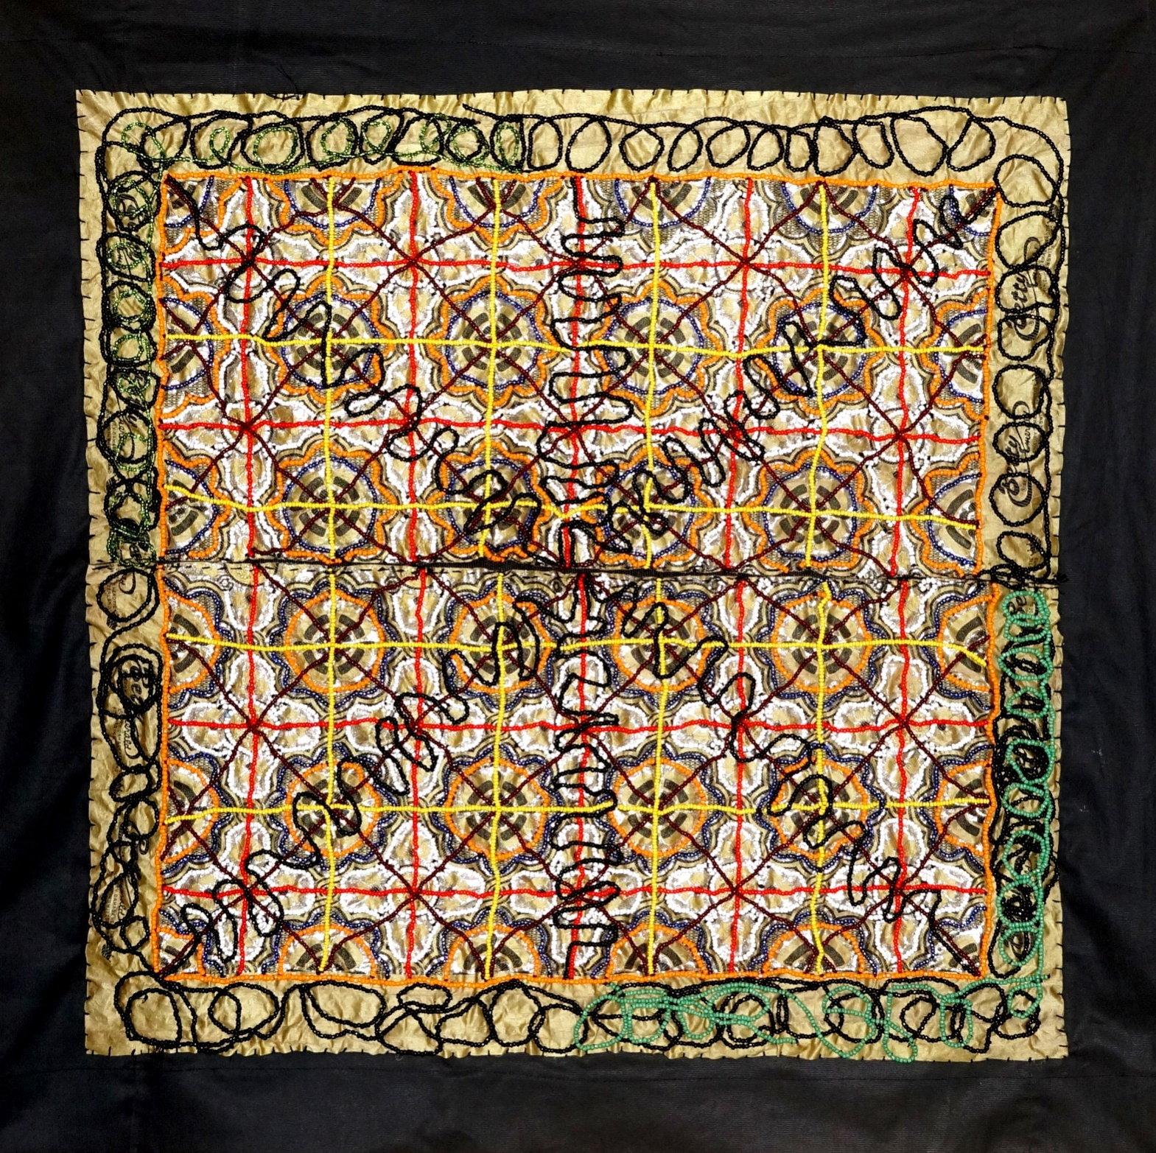
Title: Ikorita (Intersections)
Medium: Beaded Damask Tapestry
Year of Productions: 2019
Artist: Tunde Odunlade
Size: 3ft-5ins by 3ft by 4ins

Slide 11
Ikorita (Intersections) Artist’s inspiration on the piece
This piece depicts the inter-sectional challenges life portends. What you make of it becomes how well you may navigate without a GPS.
Sometimes in life we come to crossroads that almost pose confusion, but when you know where you are coming from and ultimately where you are heading then its easier for you to know which path to choose and follow at this juncture of life.
Like my friends mother will say, “If you don’t know where you are going, any road will do”
Yoruba will say “Ikorita da mu alejo” Crossroads pose challenges for a stranger.
Bottom line is, have your road map in your hand before you embark on that journey. Like the Chinese adage, A journey of a thousand miles begins with a step” while I have an addendum to that. That is; A step in the right direction.
This is simply the principle of “Beginning with the end in view”
May we don’t miss our way at the wake of our intersection in life. To overcome challenges is key to developmental procedure enroute success.
Tunde Odunlade
August 2019

Slide 12
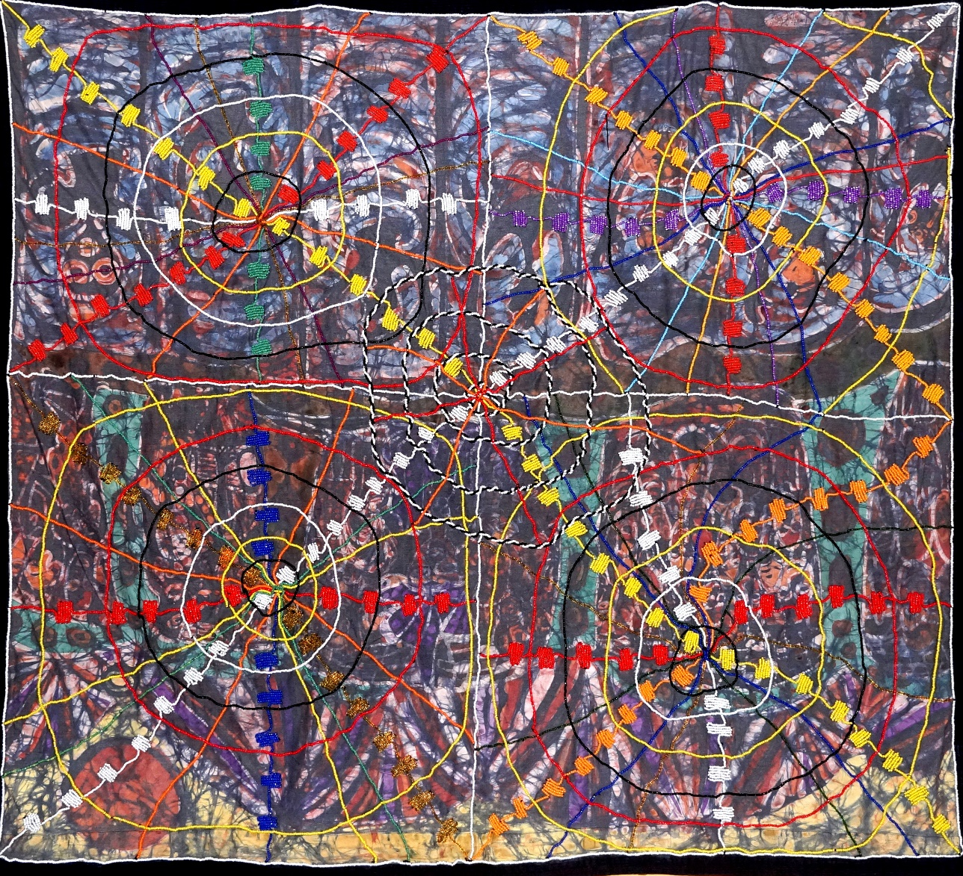
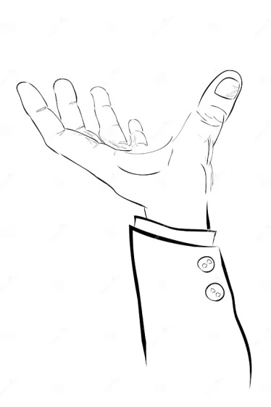
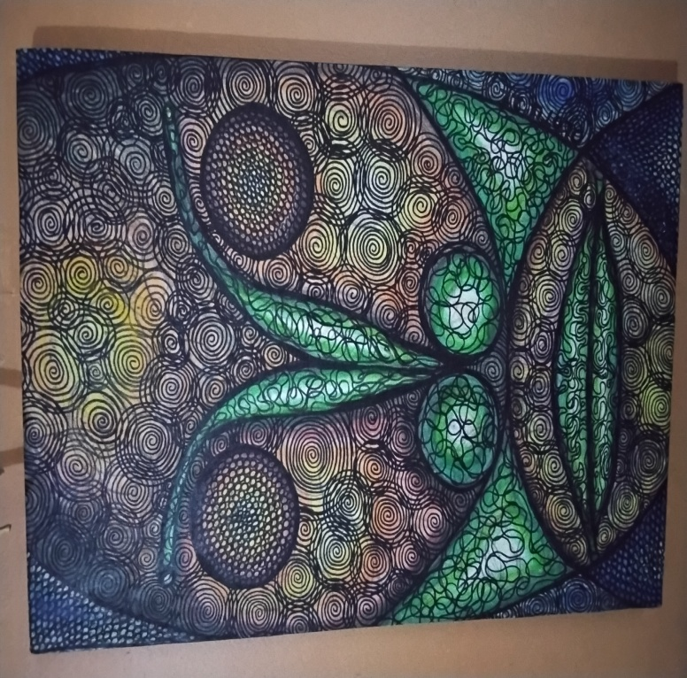
Title: ‘WWW”
Medium: Batik Quilt tapestry
Year of Production: 2016
Artist: Tunde Odunlade
Size: 5ft.1ins by 5ft. 6Ins
Collection: Estate of the Artist
Provenance: Has been exhibited and published

Slide 13
WWW Artist’s inspiration on the piece
What is the full meaning of “WWW” its World Wide Web. So, it has to do with Global affair. Now, what is Globalization? According to the English dictionary “The process of going a more interconnected world” on the other hand, I say, it is the process of making world economy dominated by the capitalists model. You either belong or you are just a mere consumer, supporting the ‘big boys’ agenda.
Today we truly live a Global Village, because at your finger tip, you can access information across the length and breadth of the Globe, just like that. The big question here is, how well are we plugged into the socket of this Global IT?
That is, are we in control of its cause and effect? Take China for example, on the Cyber world, everything does not just go with them o. They recognize that the Cyber world is filled up of junks and masterpieces but it all depends on its users. Government of some countries believe that in order to avert the danger inherent in it, they’ve decided to take control of what’s allowed into their regional system from the outer world. Even though, some may argue that, its a deprivation of their freedom of expression and so on. But as far as they are concerned it is better to be save than to be sorry.
The truth however is that with uncontrolled cybercafe, all sorts of frauds are freely perpetrated, all in the name of free world.
Again, what works for good for one, may work for bad for another, it all depends on where you may choose to visit.
Also, this piece reflects the oldie in me, by still portraying the world containing five Continents; Africa, Eurasia, Americas, .Australia/Oceania and Antarctica. However, either five or six or seven; Asia, Africa, North America, South America Antarctica, Europe and Australia. The big question here is, is Africa relevant in the Global polity? If yes, where lies our relevance? It is high time we began to take stock of what our relevance and all the comparative advantages are there in.
So that, we are not seen to be the yokels among other continents.
We can’t afford to continue in the beggarly attitude we’ve pidgin- holed ourselves. Yet, a greater percentage of the raw materials driving the world economy, come out of Africa. So, why are we living a world of penuty? Unnecessarily pitching ourselves against ourselves “Omo eleran kii ma nje’gun’, the child of a butcher shouldn’t take pride feeding on bones.
Tunde Odunlade
September 2019.

Slide 14
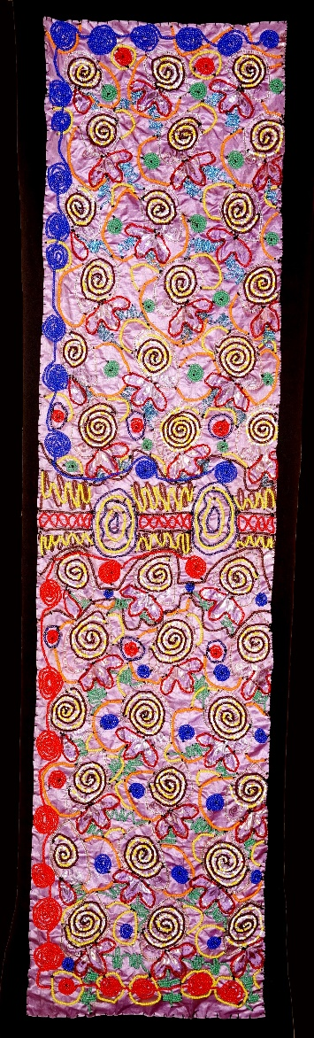
Title of Work: “A Compendium of Knowledge Shared”
Medium: Beaded Damask Tapestry
Year of Production: 2018
Artist: Tunde Odunlade
Size: 6ft.3-1/2ins
Collection: Estate of the Artist

Slide 15
A compendium of knowledge transfered Artist’s inspiration on the piece
living fear that if care is not taking, we may have to go overseas to study ifa or if you like Yoruba language in the foreseeable future, if not already happening.
Brazil, Bahia has Yoruba language for its official use, a phenomenon that may not be unconnected with the knowledge found in our ways and philosophy of life, hinged on Ifa and other indigenous knowledge of the Yoruba people of the Southwestern part of Nigeria.
A book titled “God is not one” by Stephen Protero which takes a deep study on the eight established religions that rule the world, that is, Christianity, Islam, Confucianism, Buddhism, Shintoism, Hinduism, Judaism and Yoruba Religion is a living testimony to the fact of Yoruba religion being the fastest growing ecumenism in the world today.
Ifa is a compendium of knowledge, a wisdom that is the fastest growing and spreading across the Globe.
I like the way my friend Dr. Tunde Adegbola rightly puts it; “Ifa is not a religion, but it has religion in it, Ifa is not science but it has science in it, Ifa is not mathematics, but it has mathematics in it, while Ifa is not computer, but has computation in it”.
Truly, if you understand the binary system with which Ifa oracle is defined, did you know it gave birth to the principle of the binary lights with which the computer method was created, and also called oracle in the computing system.
Ifa is studied and embraced across the length and breadth of the world today and is used to solve some of the problems of our modern day demands. It is used to consult to buy Stock exchange even on the Wall Street and many more.
There is a living fear that if care is not taking, we may have to go overseas to study ifa or if you like Yoruba language in the foreseeable future, if not already happening.
Brazil, Bahia has Yoruba language for its official use, a phenomenon that may not be unconnected with the knowledge found in our ways and philosophy of life, hinged on Ifa and other indigenous knowledge of the Yoruba people of the Southwestern part of Nigeria.
A book titled “God is not one” by Stephen Protero which takes a deep study on the eight established religions that rule the world, that is, Christianity, Islam, Confucianism, Buddhism, Shintoism, Hinduism, Judaism and Yoruba Religion is a living testimony to the fact of Yoruba religion being the fastest growing ecumenism in the world today.
A visit to the Harvard University website will blow your mind on the documentation of all Ifa chapters, written and chanted, which you can download with ease.
Tunde Odunlade
June 2019

Slide 16
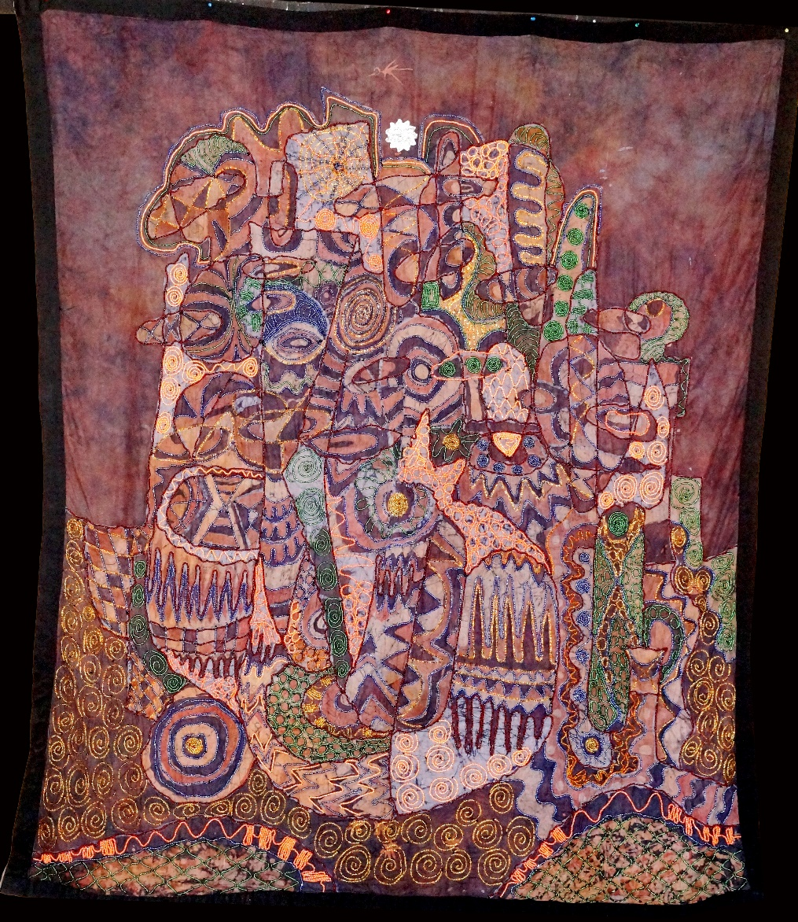
Title: Reaching for the star
Medium: Batik Quilt Tapestry (BQT)
Year of Production: 2017-18
Artist: Tunde Odunlade
Size: 8ft-1,1/2ins by 6ft-6ins
Collections: Estate of the Artist
Provenance: Was exhibited in various Galleries

Slide 17
Reaching for the star Artist’s inspiration on the piece
Reaching for the star depicts the recipe for “Success” on our paths, that which could be rough and challenging, filled with ups and downs; triumphs and travails. the attributes of normal human being.
Failure isn't the reason why it didn't happen, but because you discontinued the happenstance. A popular saying, “What you are looking for, is in the last place you look”
Bill Gates opines “If you are born poor it is not your fault, but if you die poor it is your fault”
in other words, it isn't failure until you give it up.
However, if you insist, persist and focused you are bound to make it to the top.
The pyramidal desires of man is rhetorically necessary for mention.
Naturally, Human being has these four set goals in life;
1) Survival
2) success
3) Riches
4) Power
These are four stages of man’s life
Tunde Odunlade
August 2019

Slide 18
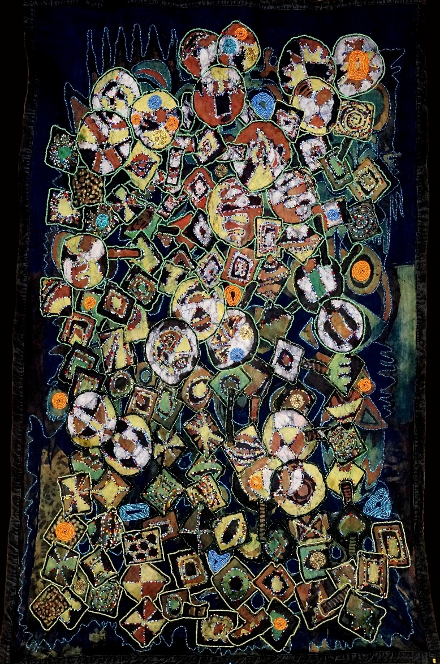
Title: Every mickle makes a muckle
Medium: Beaded Batik Quilt Tapestry (BBQT)
Year of Production: 2019
artist: Tunde Odunlade
Size: 6ft.-6ins by 4ft-3ins
Collection: Estate of the Artist.
Provenance: Has been exhibited in various galleries.

Slide 19
Every mickle makes a muckle Artist’s inspiration on the piece
Little drops of water, makes a mighty ocean. This piece accentuates the importance of every individual role in societies. How the role each individual plays builds the larger formidable society or if you like a virile nation. Every mickle make a muckle meaning, many small amounts accumulate to make a large amount. In other words, in “Bits and pieces” something whole can be derived. Likewise “Little drops of water make a mighty ocean” which the Yoruba says “esun tere tere lo ndibu nla”. This could be interpreted into various ways.
Building a house, there are days when you could only afford half a bag of cement, especially if you are the struggling type and you are using your legitimate resources, but, when the house is finally completed no one can point to the part where half a bag was once used. When the building is completed and has become wholesome you cannot point to the day you could only afford two blocks. That is the exact example of how a nation is built.
The old cliché, “Rome was not built in a day”, but, it was built everyday.
TEAM (Together Each Achieves More) work is desirable, its the only way we can develop to become a nation, when each and every little efforts are garnered and galvanized. Such is the task of Nation Building. The message therefore is, no one must abdicate his/her responsibility
No one is too small to make a difference. Like the old Saying, “If you think you are too small to make a difference, sleep next to a mosquito”
Therefore, no one should be afraid to have an idea no matter how bad. What is bad is not to have any idea at all, and if you do and is seen to be bad, just don’t implement it. Then move on from there
In bits and pieces a whole is formed.
Tunde Odunlade
June 2019

Slide 20
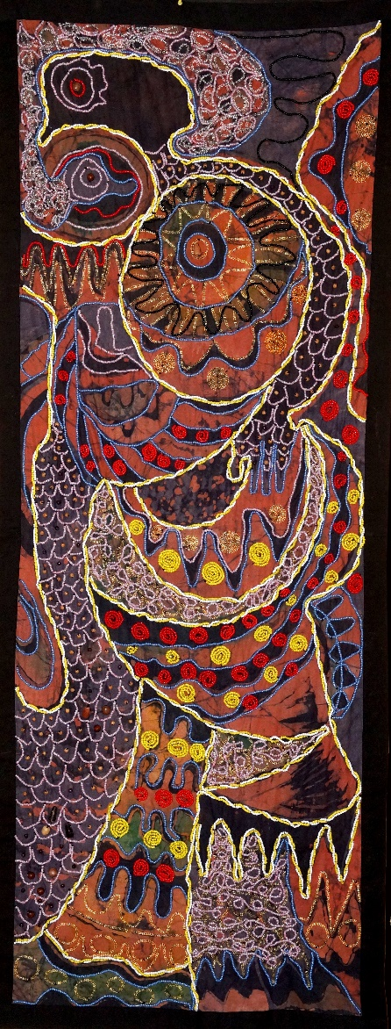
Title: Royal Bird:
Medium: Beaded Batik Quilt Tapestry
Year of Production:
Artist: Tunde Odunlade
Size:
Collection: Estate of the artist

Slide 21
Royal Bird: Beaded Batik Quilt Tapestry Artist’s inspiration on the piece
Royal Bird is a piece I cherish a lot, largely because, the bird exhibits the importance of nature in its essence.
The bird stands resplendently on the royal pedestal, wrapped round it, is its chick under its care.
Cows they show much responsibility for their calves.
Eagles for their eaglets
Lioness for their cubs
Leopardess for their cubs
Goats for their kid-billy
Tigress for their whelp
Sheep for their lamb
Snakes for their little snakes
Snakes die for their little snakes to live
May we live for our own children to live
And we pray they outlive us.
Together, we all fulfill our purpose for life
After leading a fulfilled life to complete the cycle of our destiny.
Ase.
Tunde Odunlade
September 2019

Slide 22
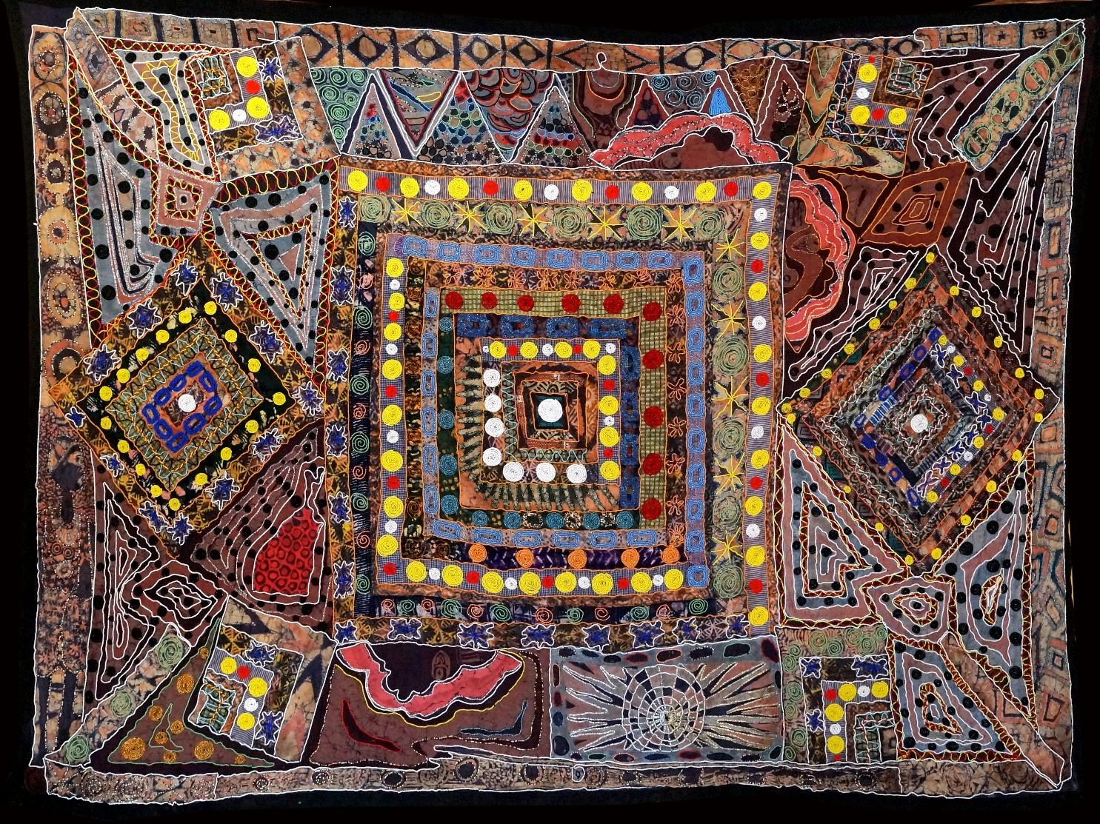
Title of Work: “Our World From above”
Medium: Beaded Batik Quilt tapestry
Year of Production: 2012-2018
Artist: Tunde Odunlade.
Size: 13ft-4ins by 9ft-9ins
Collection: Estate of the Artist
Provenance: Has been exhibited in variuos galleries

Slide 23
Our World From above Artist’s inspiration on the piece
Flying on KLM into Schippol International Airport in Amsterdam is quite revealing of the beauty inherent in our world from above. A glance from the aircraft window on the flower plantations-landscaping is worth many looks.
Holland exports to the world flowers worth over 5 billion Euros in auctions added to their foreign exchange earner and a sustainable GDP.
The Dutch are reputable for exporting Tulips around the world fresh. Apart from the economic values, it’s also a value added to the landscaping beauty that tourists from all over the world make a must see destination. Is it the cynosure or the scintillating aroma of the flower plantations? especially the tulips.
No wonder why Cleveland said, “Give me my flower now that I can smell it” Without question flower radiates infinite-agape-love.
Georgia O’Keefe says “Nobody sees a flower really, it is so small. We haven’t time to see it, and to see takes time – like to have a friend takes time...” Well, the Dutch defy this statement by bringing to the fore the beauty in flowers for all to see, even at a distant.
A deep look into the world of Claude Monet the french painter of flowers is also more encouraging to really further fall in love with flowers, as he says “I must have flowers always and always”
No wonder why the Dutch Renaissance artist Van Gogh also says,
“How right it is to love flowers and the greenery of pines and ivy and hawthorn hedges; they have been with us from the beginning” All of these go to show nature’s endowment that must never be taken with levity and must be an integral part of our world, always. I love flowers. Think about the lovely perfumes made out of flowers.
This piece also takes a swipe into a picture you can find at the United States Geological Survey (US-GS) building-headquarters in Virginia USA, which shows the picture of the earth taken from the space.
Looking at the picture down from the atrium of the building, all you could see is a solid picture without an easily identifiable region or continent but the different colors depicting nature’s essence.
If only we understood nature’s essence-oneness, we will see life in a unifying whole and therefore be humble to respect other creatures as subject to co-habitation.
Tunde Odunlade
August 2019.

Slide 24
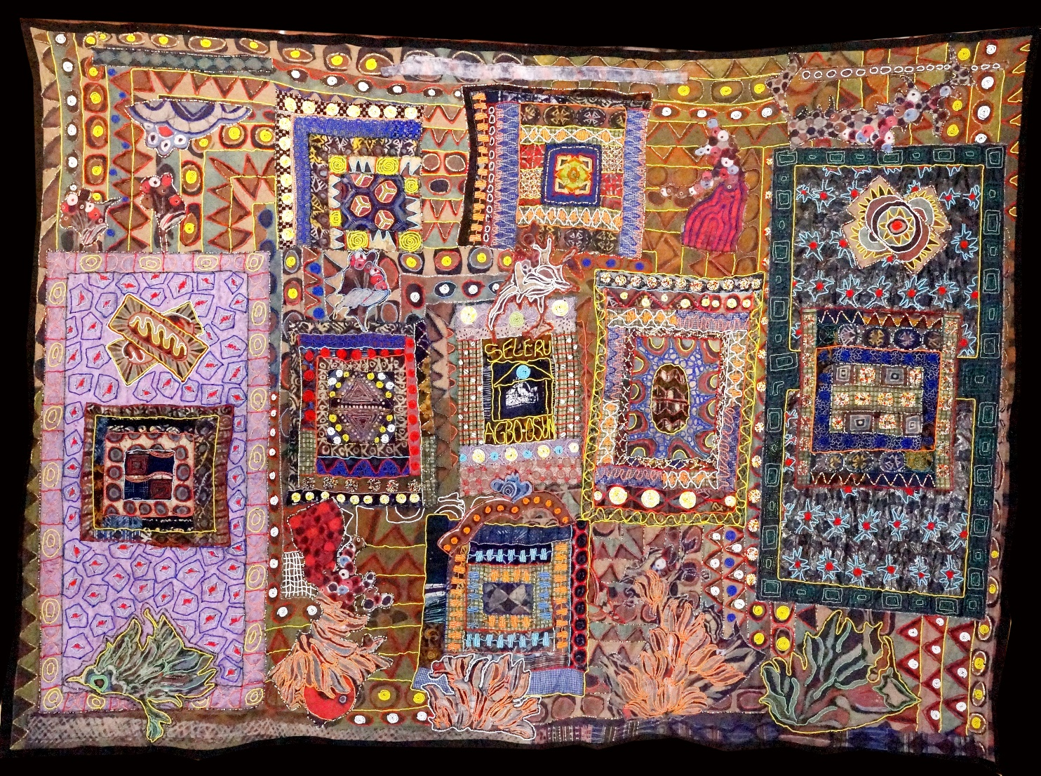
Title of Work: Seleru Agbo
Medium: Beaded Batik Quilt tapestry
Year of Prodution: 2011-2018
Artist: Tunde Odunlade
Size: 9ft.31ns by 14ft
Collection: Estate of the Artist.
Provenance: Was exhibited in various galleries

Slide 25
Seleru Agbo Artist’s inspiration on the piece
The central focal point of this piece “Seleru Agbo” is the potency underlying in herbal medicine. Like the popular song, Seleru agbo, agbara agbo, l’Osun fi nwo’mo re ki dokita o to de, literally translates as; the natural medicinal spring, the medicinal stream were administered by Osun before the advent of western orthodox medicine.
Osun goddess of fertility, a deity whose prowess is synonymous with healing and blessings for its believers, that which now cuts across borders. The annual Legendary Osun Oshogbo carnival is now a Global inheritance.
Roots, leaves and barks of trees and shrubs form the basis of our medicinal recipe, both western and homeopathic drugs. It is however regrettably noted that synthetic materials now used for modern medicine are the cause of all the strange adverse effects people get out of modern day drug administration.
Without question, the contributions Africa has made to human civilization, especially the endowment of raw medicinal substance God gave us, is immense, but doesn’t get talked about.
Thank goodness, our people have become more conscious of this gift for a healthier us. Having said that, my advice therefore is to ensure that we monitor the proliferation of all sorts of medicine making the round these days, to ascertain their proficiency and efficacy.
Tunde Odunlade
June 2019.

Slide 26
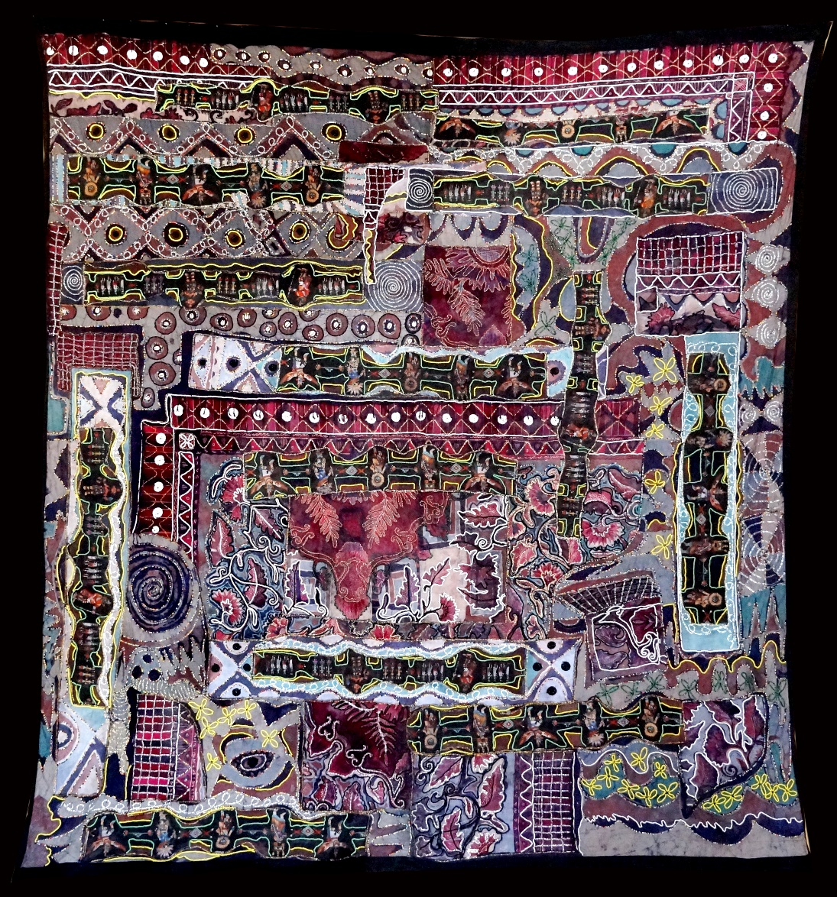
Title of Work: The way we Are
Medium: Beaded Batik quilt Tapestry
Year of Production 2011-2017
Artist: Tunde Odunlade
Size:
Collection: Estate of the Artist
Provenance: Has been exhibited in Art venues.

Slide 27
The way we Are Artist’s inspiration on the piece
The way we are, is an ultimate description of the inter connectivity of our world. While I was traveling in New Mexico, USA, little did I know I was going to come up with this gargantuan piece highlighting our inter dependency and connectivity. Until I got to San Antonio, Texas where my sister, Ms. Robin Raquet. out of the blue offered to give me a large commercial fabric that contained images of Hopi Kachina Dolls, a subject I’ve just been recently fascinated by. I quickly reached out for this offer and couldn’t wait to return back home into my studio in Nigeria.
I’d had a huge piece of East Indian fabric which I’ve cherished for a long time, a piece that was in fact traded for in a friend’s art gallery Worldly Possession Gallery in Santa Fe, New Mexico. This gallery was owned by Elinor Gollay a very close friend.
Without much ado, I quilted the two fabrics together, waxed and dyed it, in my usual methodology of Batik process. The African aesthetics incorporated on the piece clearly shows how our world together can be peaceful and loving, just by understanding each other better.
I took the finished product back to the US and the curators at the Smithsonian, National Museum of African Art, (NMAFA) Washington DC immediately fell in love with it and they offered to acquire it for their permanent collection because, according to the assistant director of the museum, Chris Kreamer PHD, “I’ve never seen an African artist doing such a cross cultural piece in this way”. But few weeks later when my cheque ought to have been ready, a message came from one senior curator of the museum saying that, they can’t continue with the purchase of the piece, because, they had consulted an expert at the Native American Indian Museum, Smithsonian, who advised they should not acquire the piece because Hopi Kachina Doll should not be touched under any context by a non native. It would have been a different story if NMAFA were to be a State or privately owned museum but because it is a Federal establishment, they shouldn't touch it, she reiterated, “it is sacred to the Hopi people”.
Having gotten this message, I was taken aback, that first and foremost, it’s a commercial fabric bought from a market by the giver, why should it now be an issue? I queried.
It was this declining that spurred my interest in finding out more about this special specie Hopis. It turned out that, Hopi people have suffered sour experience in the hands of some European entrepreneurs with whom they entrusted and gave the right to this vibrant cultural icons but they were treated with disdain in return for their trust. Henceforth, they no longer trust anyone using these images.
The good news however, is that, mine was seen from a positive point of view. So, it is permitted, because, I’m using the images to showcase the positive vibes of our world. Here we are, having the world uniting on fabrics which can surely rub off on the practicality of our real world; as the Yoruba says, “Eniyan laso mi”.
I love Hopi Kachina Dolls. world is but one
Tunde Odunlade
June 2019

Slide 28
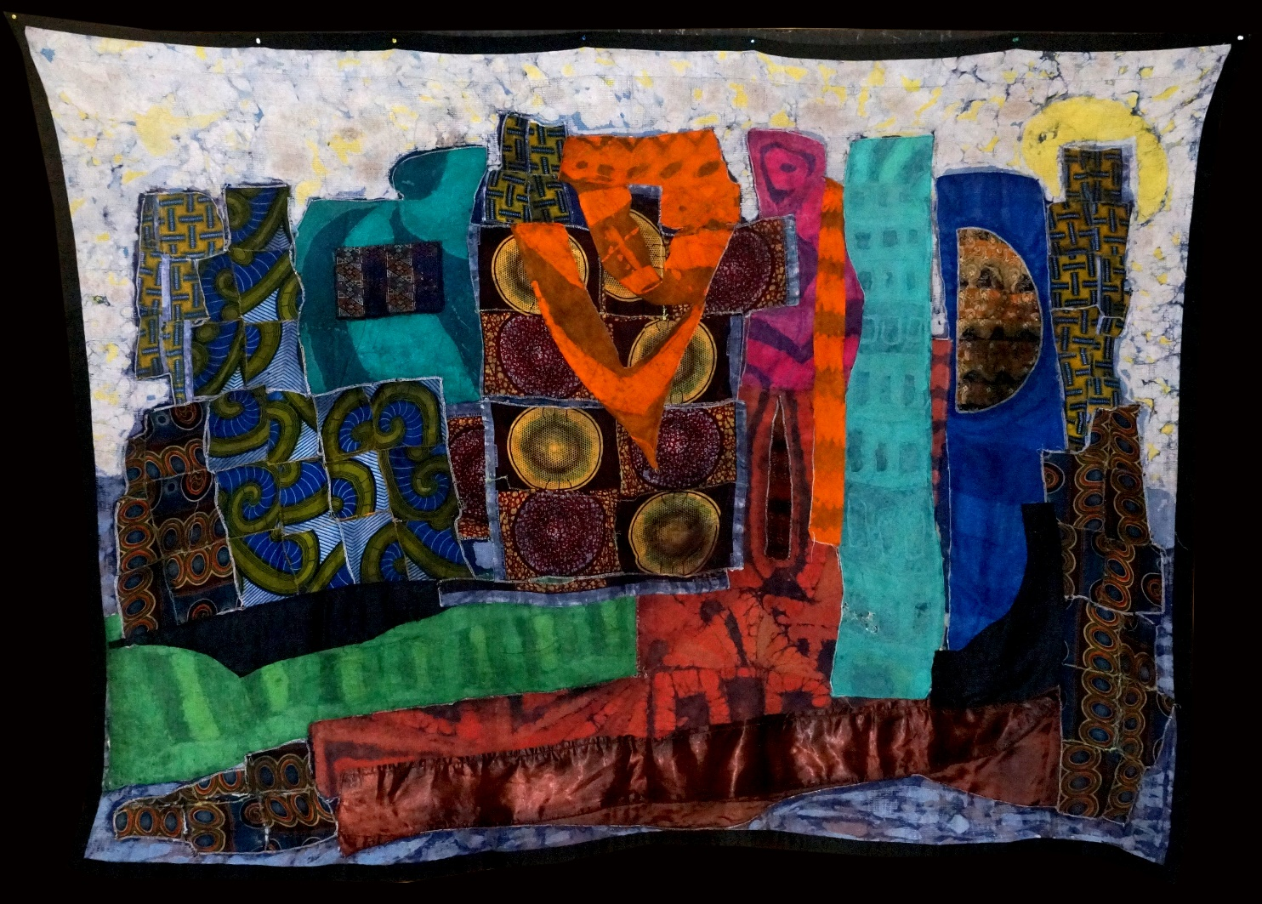
Title: Concrete Jungle
Medium; Batik Quilt Tapestry
Year of Production: 2014
Artist: Tunde Odunlade
Size: 5ft.10-1/2ins
Collection: Estate of the Artist
Provenance: Has been exhibited in Museums and Galleries

Slide 29
Concrete Jungle Artist’s inspiration on the piece
Concrete Jungle is a reflection on the life in big cities where people in the community are just a part of the economic system, which could almost be described as a vicious cycle.
People are basically acting to help the corporate world grow, just for their own mere survival as if they don’t have a mind of their own. That is the price you pay living in big cities.
Thanks to some cities who integrate green-parks for the people to refresh. I love the Central Park in New York City, without it New-Yonkers would have gone ballistic. Central Park in the heart of New York City is a life saver.
Tunde Odunlade
September 2019.

Slide 30
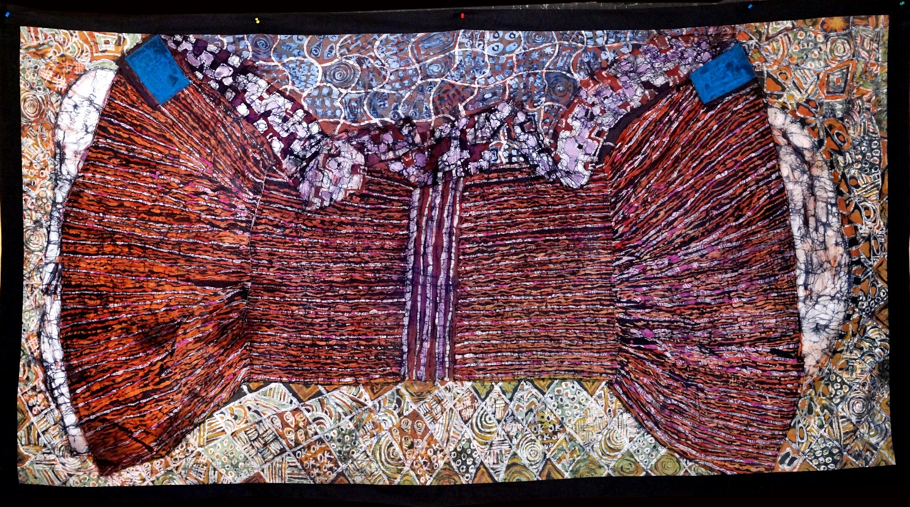
Title: Bawo o ka’ju ilu, yiya nii ya
Medium: Batik Quilt Tapestry
Year of Production: 2017
Artist: Tunde Odunlade
Size: 4ft by 7ft.31/2.
Collection: Estate of the Artist

Slide 31
Bawo o ka’ju ilu, yiya nii ya Artist’s inspiration on the piece
The Yoruba believes that one that is not competent should have no business taking a leadership role, otherwise, its going to be chaos and cantankerousness that will be the order of the day.
Question: what are the attributes of good leadership”? good vision, the support from his subject and whatever he has to say are subject to debate and scrutiny. That means he has to be a good listener and good decision taker. He or she doesn’t have to be a genius
The adage b’awo o ka’ju ilu, yiya nii ya literally translates as when the skin does not cover the face of the drum, it will tear and there will be no sound coming out of the wood.
Ilu in Yoruba is drum. Its made out of the wood carved in a cylindrical shape and hollowed on the inside and then covered with goat skin which then produces sound that mimics the language of the Yorubas which is a tonal language of Do Re Mi. The leather straps wrapped the wood is skillfully squeezed to alternate the sound which produces sonorous and familiar tunes.
The talking has drum no comparison in the world of music.
Tunde Odunlade
September 2019.

Slide 32
Please note, that this price-list has two prices marked ‘ARP’ which stands for “Actual Retail Price “While ‘SLRP’ means “Suggested Local Retail Price”.
TITLE | MEDIUM | ARP USD | SLRP NGN
Ikorita | Beaded damask Tapestry (BDT) | 4000 | 650,000
WWW | Beaded Batik Quilt Tapestry (BBQT) | 4000 | 650,000
Royal Bird | Beaded Batik Quilt Tapestry (BBQT) | 4000 | 650,000
A compendium of knowledge transferred | Beaded Damask Tapestry (BDT) | 4000 | 650,,000
Olugbodi | Beaded Damask tapestry (BDT) | 4000 | 650,000
Every Mickle makes a Muckle | Beaded Batik Quilt Tapestry (BBQT) | 7500 | 2,000,000
Reaching for the Stars | Beaded Batik Tapestry (BBT) | 6500 | 1,800,000
At the Calvary | Beaded Batik Tapestry (BBT) | 6000 | 1,700,000
Prayers | Beaded Damask Tapestry (BDT) | 4000 | 650,000
Seleru Agbo | Beaded Batik Quilt Tapestry (BBQT) | 25000 | 6,000,000
Our world from above | Beaded Batik Quilt Tapestry (BBQT) | 25000 | 6,000,000
The Way We Are | Beaded Batik Quilt Tapestry (BBQT) | 24000 | 5,500,000
Eiye t’o nj’eso kii ke | Beaded Batik Tapestry (BBT) | 22000 | 5,000,000
B’awo o ka’ju ilu | Batik Quilt Tapestry (BQT) | 10000 | 1,750,000
Concrete Jungle | Batik Quilt Tapestry (BQT) | 12000 | 2,000,000
This World Our World | Batik Quilt Tapestry (BQT) | 25000 | 6,000,000

